Slide 1

ESD Seminar (3v0)
(training APAC)
Jos van de Giesen
Product Field Quality Manager APAC
(ESD Coordinator)
BU Mobile & Personal

Slide 2
ELECTRO STATIC DISCHARGE

Slide 3

ESD ITEMS:
ESD GENERAL
ESD TESTING (Destructive)
ESD HANDLING
ESD PACKING
ESD STANDARDS
ESD CONTROL
Questions

Slide 4
ESD ITEMS:
ESD GENERAL
ESD TESTING (Destructive)
ESD HANDLING
ESD PACKING
ESD STANDARDS
ESD CONTROL

Slide 5
ESD DEFINITIONS
ElectroStatic Discharge: (ESD) A transfer of electrostatic charge between bodies at different electrostatic potentials caused by direct contact or induced by an electrostatic field.
ElectroStatic Discharge Sensitive Device: (ESDS) A discrete device, integrated circuit or assembly that may be damaged by electric fields or electrostatic discharge encountered in routine handling, testing and transit

Slide 6
RELATION ESD <> EMC
PRODUCT
MACHINE
ESD
EMC

Slide 7
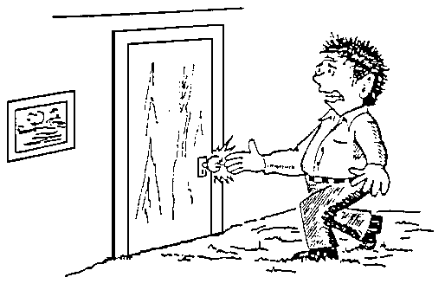
STATIC

Slide 8
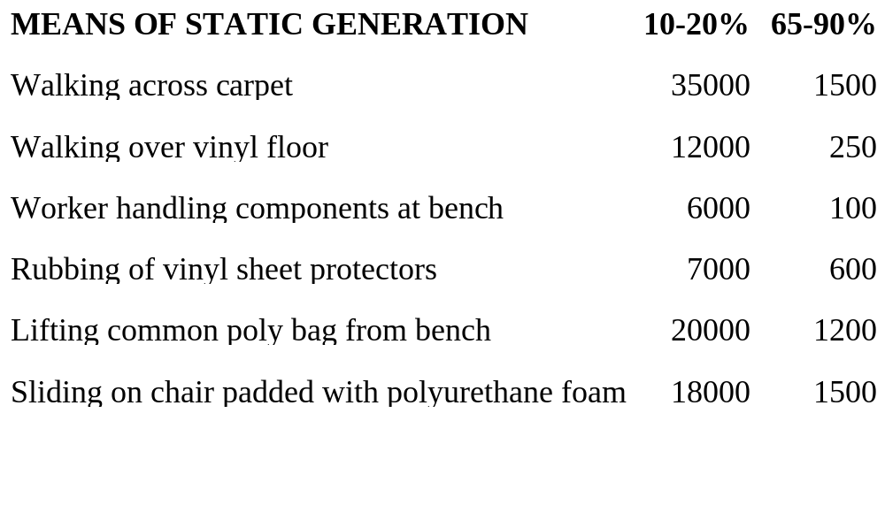
STATIC GENERATION
VOLTAGE GENERATED AT R.H.:
Above 3000V you can feel the dis-charge.
All Semiconductor devices are ESD-Sensitive

Slide 9


ESD SIGN

Slide 10
ESD COST
Impact includes:
Material losses.
Labor costs.
Re-work costs.
Burden & overhead expense.
Warranty costs.
Field Service costs.
........... Customer satisfaction.

Slide 11

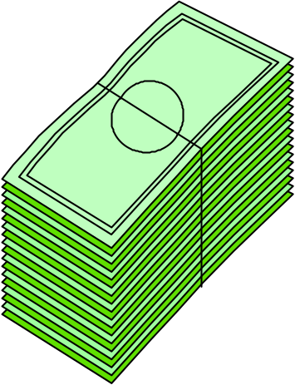
ESD COST
Impact on Electronics
Device cost : $ 2-4
Sub assembly : $ 10-15
Finished product : $ 40 +
Field service : $ 300 +

Slide 12
ESD: Types of Failure:
Catastrophic Failure: Device does not meet designed performance standards.
Latent Failure: Device meets designed performance standards, but fails before end of designed life.

Slide 13
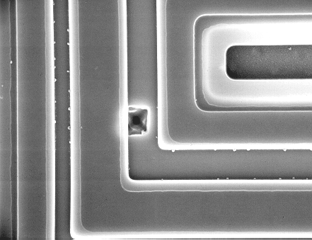
ESD DAMAGE
BF909R MOSFET

Slide 14
ESD DAMAGE
Catastrophic vs. latent

Slide 15
ESD FAILURES
Catastrophic vs. Latency *)
Failure type: Commercial: Military:
For each Catastrophic
Failure found at plant ... 1 1
The number of
Latent Failure possible sent
to Customers are ..... 4 9
*) Out of 15 years over 200 USA companies.

Slide 16
ESD
What is Static ?
What causes it ?
        The tribo-electric charge
causes 98% of all ESD problems

Slide 17
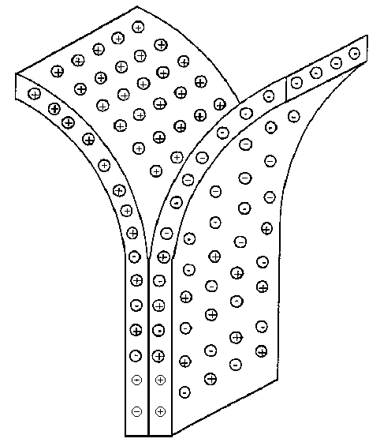
SEPARATE MATERIALS
CHARGE DISTRIBUTION
OF TWO UNLIKE
MATERIALS BEING
SEPARATED

Slide 18
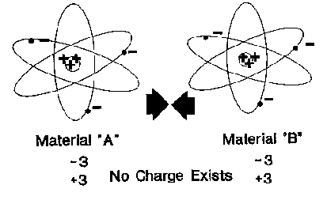
Triboelectric Charge
Two materials make direct contact

Slide 19
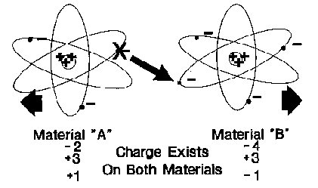
Triboelectric charge then separate ....

Slide 20
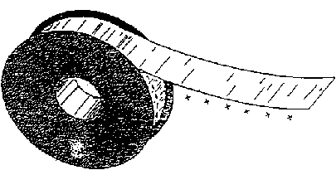
SEPARATE MATERIALS
SCOTCH TAPE

Slide 21
TRIBOELECTRIC SERIES
POSITIVE
Quarts, Glass
Mica, Human hair
Nylon, Wool
Lead, Silk, Aluminum
PAPER & COTTON
Amber, Sealing wax, Hard rubber, nickel gold
Brass, Silver, gold, Platinum
Acetate, Rayon, Polyester
Celluloid, Orlon, Saran, Polyurethane, ethylene, propylene
PVC (Vinyl), Silicon, Teflon
NEGATIVE

Slide 22
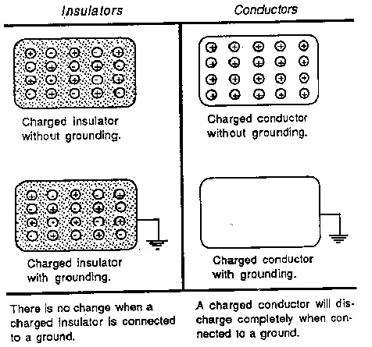
DISCHARGE EFFECTS ON ROUNDING

Slide 23
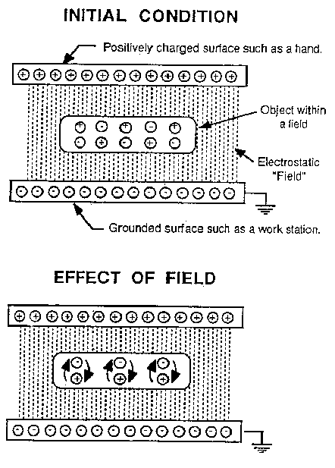
EFFECTS IN ELECTROSTATIC FIELD

Slide 24
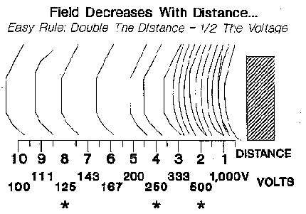
ELECTROSTATIC FIELD

Slide 25
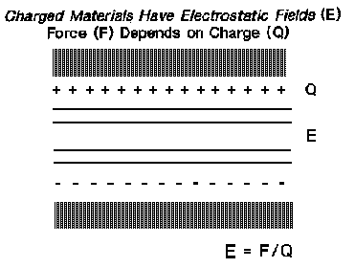
FIELDS

Slide 26
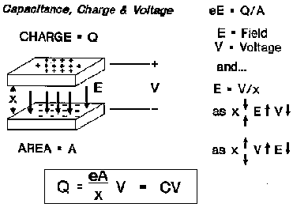
Capacitance (1)

Slide 27
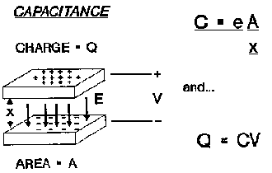
Capacitance (2)

Slide 28
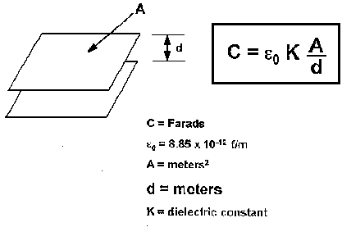
Capacitance (3)

Slide 29
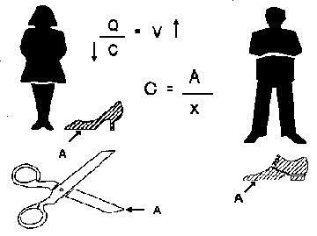
Capacitance (4)

Slide 30
ESD ITEMS:
ESD GENERAL
ESD TESTING (Destructive)
ESD HANDLING
ESD PACKING
ESD STANDARDS
ESD CONTROL

Slide 31
ESD TESTING
HUMAN BODY MODEL (HBM)
  direct discharge to device.
MACHINE MODEL (MM)
  direct discharge between device & small conductive machine parts.
CHARGED DEVICE MODEL (CDM)
  grounding a charged device.
FIELD INDUCTION MODEL (FIM)
  grounding device in electrostatic field.
ESD ZAP (Mobile phones, 8kV)
  Discharge through antenna or at outside of phone

Slide 32
ESD TESTING
Sensitivity levels
Samples are tested on ESD on HBM and MM as part of Product Release Program.
ESD Testing is a design test.
ESD Testing is destructive.
Correlation of ESD testers is difficult.

Slide 33
ESD TESTING
Testprocedures
Test procedure Transient Energy
SNW-SQ-302C
HUMAN BODY MODEL (HBM)
UZW-BO/FQ-A302 # SNW-FQ-302A
MACHINE MODEL (MM)
UZW-BO/FQ-B302 # SNW-FQ-302B

Slide 34
ESD TESTING testmethod
Verification test with fixed level.
Determination of sensitivity level.
- 3 pos. and 3 neg pulses.
- at all pins.
- increase voltage step by step.
For all ESD Testing: Device should fulfill all its electrical parameters.

Slide 35
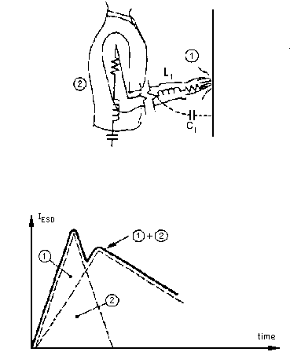
ESD TESTING
HUMAN BODY MODEL (1)

Slide 36
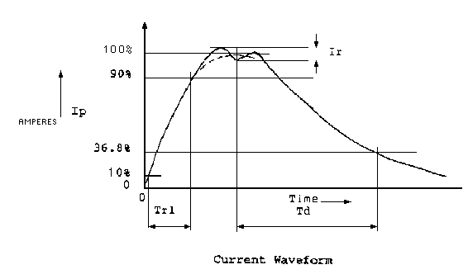
ESD TESTING
HUMAN BODY MODEL (2)

Slide 37
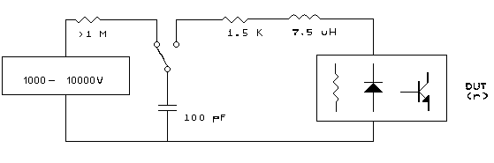
ESD TESTING
HUMAN BODY MODEL (3)
ELECTRICAL SCHEME
Effective circuit, actual circuit construction
might be different.

Slide 38
ESD TESTING
CLASSIFICATIONS HBM
CLASS 1 < 2000V
CLASS 2 2000 - 3999V
CLASS 3 > 4000V

Slide 39
ESD TESTING
CLASSIFICATIONS HBM per S-5.1
CLASS 0 0 - 249V
CLASS 1A 250 - 499V
CLASS 1B 500 - 999V
CLASS 1C 1000 - 1999V
CLASS 2 2000 - 3999V
CLASS 3A 4000 - 7999V
CLASS 3B > 8000V

Slide 40
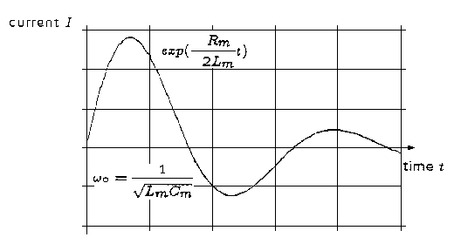
ESD TESTING
MACHINE MODEL (1)
WAVEFORM

Slide 41
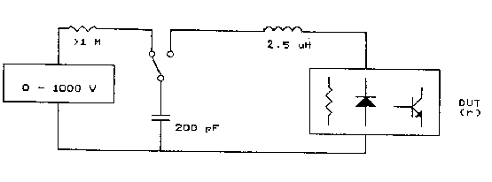
ESD TESTING
MACHINE MODEL (2)
ELECTRICAL SCHEME
R
L
Model 1: L = 0.75uH, R = 10Ohm
Model 2: L = 2.5uH, R = 25Ohm
Nominal values, precise values may be varied
to achieve the correct waveform

Slide 42
ESD TESTING
CLASSIFICATIONS MM
CLASS 1 0 - 199V
CLASS 2 200 - 399V
CLASS 3 > 400V

Slide 43
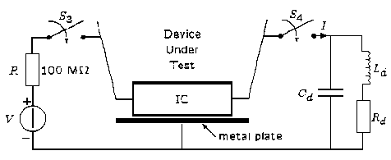
ESD TESTING
CHARGED DEVICE MODEL

Slide 44
ESD/EOS
Detection of failure mode
Test samples on HBM, MM and CDM and carry out Failure Analysis.
EOS: determine the several possible failures and carry out these tests and analysis.
  Possible tests are:
  Overvoltage, spikes on power supply.
  Too high input drive.
  No load.

Slide 45
ESD ITEMS:
ESD GENERAL
ESD TESTING (Destructive)
ESD HANDLING
ESD PACKING
ESD STANDARDS
ESD CONTROL

Slide 46
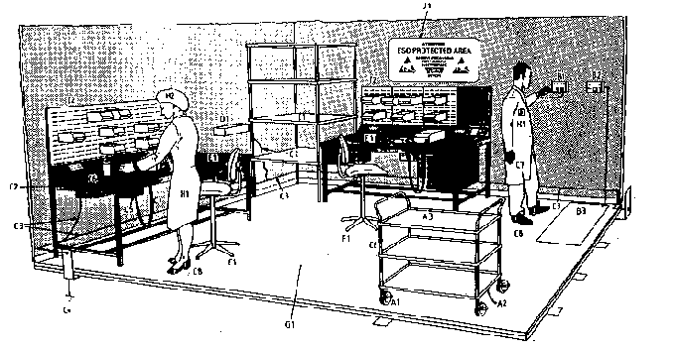
ESD HANDLING
ESD Protected Area (EPA)

Slide 47
ESD HANDLING
Example of EPA sign
ATTENTION
ESD PROTECTED AREA
OBSERVE PRECAUTIONS
FOR HANDLING
ELECTROSTATIC
DISCHARGE
SENSITIVE
DEVICES

Slide 48
ESD HANDLING
Example of EPA sign (High voltage)
ATTENTION
HIGH VOLTAGE
ESD PROTECTED AREA
OBSERVE PRECAUTIONS
FOR HANDLING
ELECTROSTATIC
DISCHARGE
SENSITIVE
DEVICES

Slide 49
ESD HANDLING
ESD Protected Area (EPA) :
a Bench.
a Store.
an area of work.
a field work area
a work station and equipment
(e.g. solder flow machine)

Slide 50
ESD HANDLING
Example of EPA Boundary label
ESD BOUNDERY

Slide 51
ESD HANDLING
Basic materials & requirements : (1)
General: measured at 25% R.H.
Working surface.
Floors.
Seating.
Garment.
Gloves and finger cots.
Wrist straps.

Slide 52
ESD HANDLING
Basic materials & requirements : (2)
Leg straps, toe and heel straps.
Electrostatic dissipative footwear.
Ionization.
Humidity control.
ESD earth facility.
Earth bonding points.
Ground cords.

Slide 53
ESD HANDLING
Basic materials & requirements : (3)
Temporary work surfaces and flooring.
Tools.
Trolleys, carts and wagons.
Test & process equipment.
Packing materials.

Slide 54
ESD HANDLING
MINIMUM REQUIREMENT
Use of Wrist strap.
Table dissipative.
Tools ESD safe.
Packing ESD safe.
Training.
Audits.

Slide 55
ESD HANDLING
Example of EBP label
EBP

Slide 56
ESD HANDLING
Ground connections
WRIST STRAP
WORKSURFACE
R
FRAME
R
CORD
EBP
EARTH FACILITY
GROUND

Slide 57
ESD HANDLING
Possible Ground connections (1)
EBP
WRISTSTRAP
EBP
EARTH FACILITY
SURFACE
MAT
FRAME
FLOOR
MAT

Slide 58
ESD HANDLING
Possible Ground connections (2)
Optional
EBP
WRISTSTRAP
EBP
EARTH FACILITY
MAT
SURFACE
EBP
in FRAME
FRAME
FLOOR

Slide 59
ESD HANDLING
Possible Ground connections (3)
EBP
EBP

Slide 60
ESD HANDLING
Possible Ground connections (4)

Slide 61
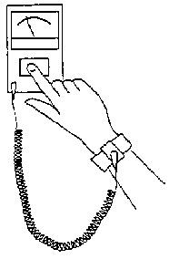
ESD HANDLING
Daily check of Wrist strap
Resistance to ground
for wrist strap.
Wrist strap should
make direct contact
with the skin

Slide 62
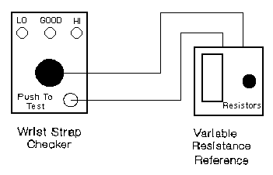
ESD HANDLING
Calibration of Wrist strap checker.

Slide 63
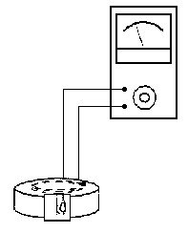
ESD HANDLING
Check of Wrist band
Resistance to
groundable point
for a wrist band

Slide 64
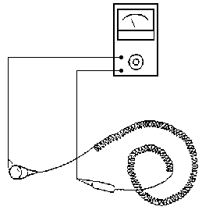
ESD HANDLING
Check of ground cord
End to end
Resistance for
a ground cord.

Slide 65
ESD HANDLING
CORDLESS ESD PROTECTION
CORDLESS ESD PROTECTION SHOULD NOT BE USED BECAUSE:
Cannot eliminate 100% ESD charge.
Recheck/Refill yearly by supplier ?
Unknown chemicals are used which might be dangerous for our assembly processes or for persons.

Slide 66
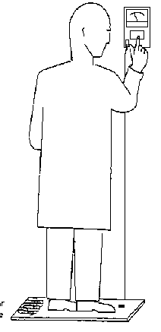
ESD HANDLING
Daily check of footwear
Resistance to ground
for footwear

Slide 67
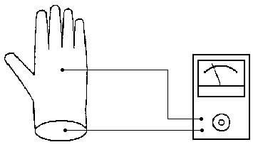
ESD HANDLING
Check of gloves
Surface to groundable point resistance for gloves.

Slide 68
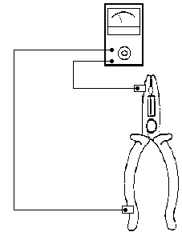
ESD HANDLING
Check of tools
Surface to groundable
point resistance for
tools.

Slide 69
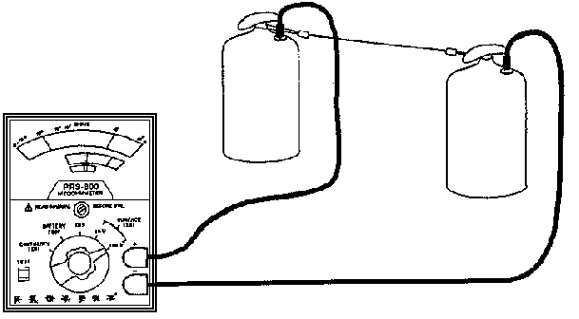
ESD HANDLING
Point to point (Rtt) measurement

Slide 70
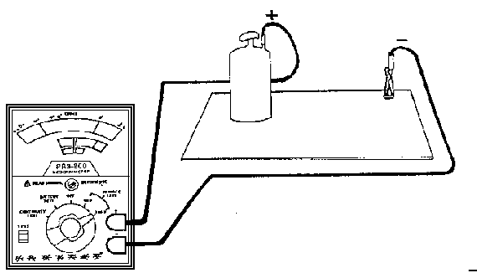
ESD HANDLING
Point to Ground (Rtg) Measurement

Slide 71
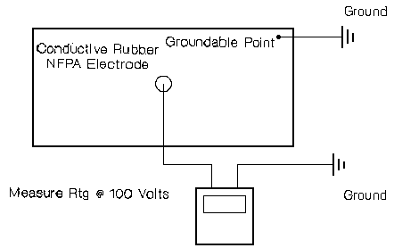
ESD HANDLING
Audit worksurface, system check

Slide 72
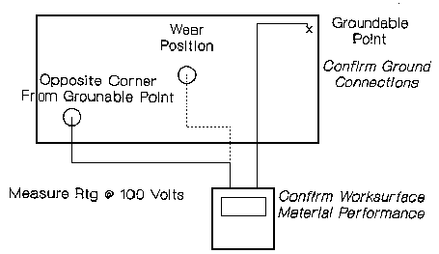
ESD HANDLING
Audit worksurface, resistance to ground

Slide 73
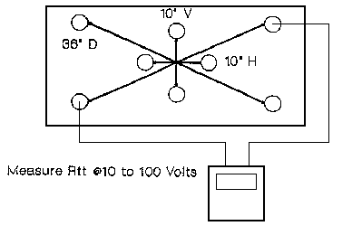
ESD HANDLING
Audit worksurface, point to point

Slide 74
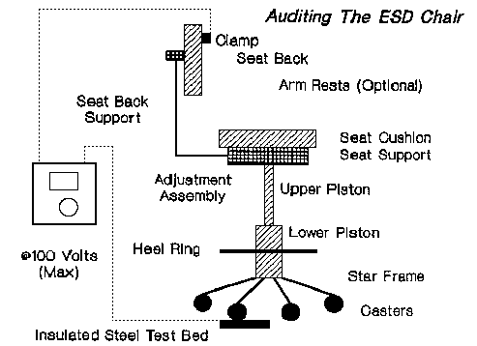
ESD HANDLING
Check of ESD chairs

Slide 75
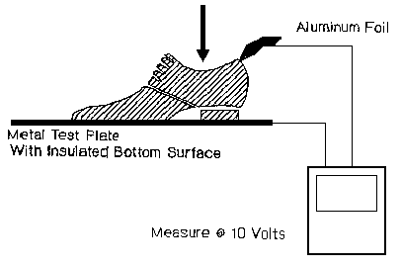
ESD HANDLING
Measuring only the shoe
place person
here

Slide 76
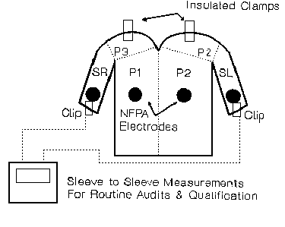
ESD HANDLING
Measuring the Garment

Slide 77
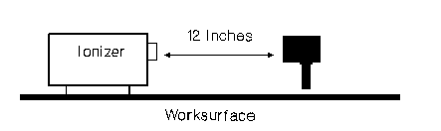
ESD HANDLING
Check of Ionizer

Slide 78
ESD HANDLING
Trolley

Slide 79

ESD HANDLING
Example of EPA exit sign
ATTENTION
YOU ARE LEAVING
THE EPA
(According IEC 61340)

Slide 80
ESD ITEMS:
ESD GENERAL
ESD TESTING (Destructive)
ESD HANDLING
ESD PACKING
ESD STANDARDS
ESD CONTROL

Slide 81
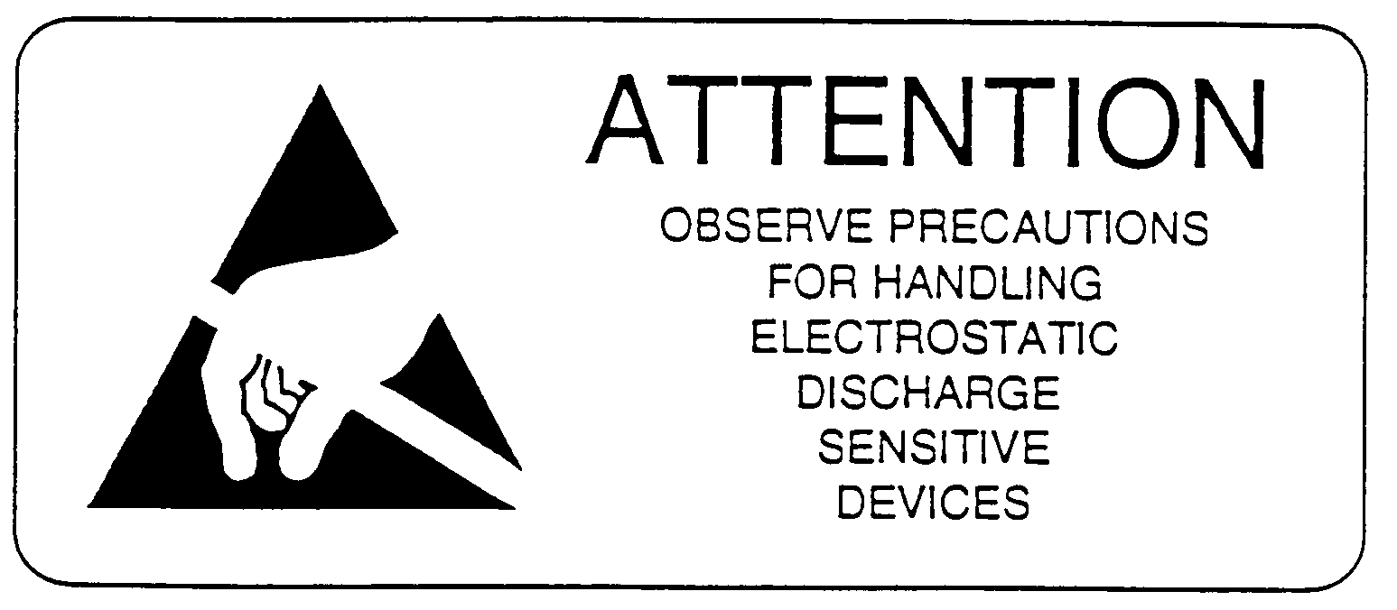
ESD PACKING
Example of Warning label for ESDS

Slide 82
ESD PACKING
PACKING REQUIREMENTS FOR
PD SEMICONDUCTORS. (SNW-SQ-401,
Including ESD requirements)
LOCAL PROCEDURES.

Slide 83
ESD PACKING
MATERIALS:
- Antistatic materials.
- Materials with resistivity properties.
Electrostatic shielding materials.
Electrostatic conductive materials.
Electrostatic dissipative materials.
Insulative materials.

Slide 84
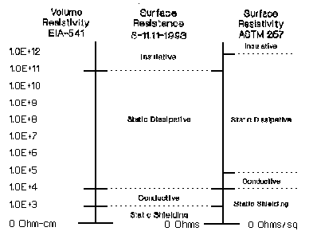
ESD PACKING

Slide 85
ESD PACKING
Surface resistivity tester (Ohm/sq)
5cm

Slide 86
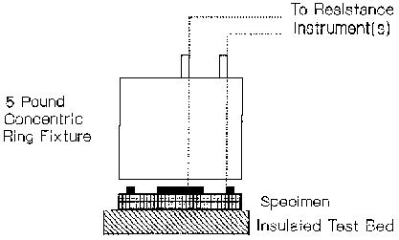
ESD PACKING
Surface resistivity measurement

Slide 87
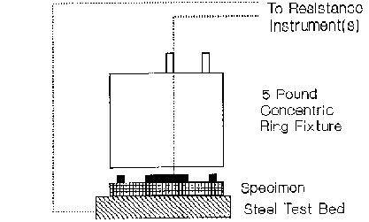
ESD PACKING
Volume Resistivity Measurement

Slide 88
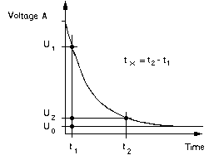
ESD PACKING
Static Decay Time

Slide 89
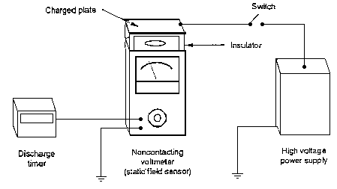
ESD PACKING
Charged Plate Analyzer

Slide 90
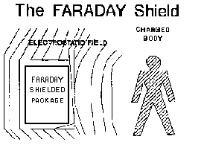
ESD PACKING

Slide 91

ESD PACKAGE

Slide 92
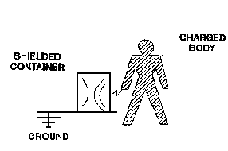
ESD PACKAGE

Slide 93
ESD PACKING
MATERIALS FOR PACKING
INTIMATE PACKING:
  makes direct contact with ESDS.
PROXIMITY PACKING:
  not making contact with ESDS, but is used to enclose one of more devices.
SECONDARY PACKING:
  additional protection on the outside of proximity

Slide 94
ESD PACKING
MATERIALS FOR PACKING
Also defective products should be returned ESD safe, this to avoid further damaged due to transport and handling.
Also during handling of defective products standard ESD pre-cautions should be taken similar as for good products

Slide 95
ESD ITEMS:
ESD GENERAL
ESD TESTING (Destructive)
ESD HANDLING
ESD PACKING
ESD STANDARDS
ESD CONTROL

Slide 96
ESD STANDARDS
JESD 625A (adapted by Philips, see SNW-SQ-604)
IEC 61340 - 5 - part 1 & part 2
EOS/ESD ASSOCIATION (S20.20)
Local Procedure
EN 100 015 STANDARD.
IEC 1330.
Handbook ESD Protection PHILIPS Nijmegen. (RNV-63/A004)

Slide 97
ESD STANDARDS
Need for One international Standard
EN100015
IEC 61350
JESD625A
PHILIPS SEMICONDUCTORS
PLANT 1
PLANT 2
CUSTOMERS

Slide 98
ESD STANDARDS
IEC TECHNICAL COMMITTEE 101
Task: To prepare a standard on the general requirements for the protection of electronic devices against static electricity.
This standard shall apply only to the manufacture and use of electronic devices and assemblies.
The following documents are be used as a basis for this future standard:

Slide 99
ESD STANDARDS
IEC 61340-5-1 (General requirements)
IEC 61340-5-2 (User guide)
The European standard EN 100 015 and its present revision.
The proposal 47 (Germany) 794.
The committee draft 47 (Secretariat) 1330 and the relevant compilation of comments to be issued by the secretary of TC47.
Any other relevant document or national standard.
At this moment simple version in discussion.

Slide 100
ESD STANDARDS
LOCAL ESD PROCEDURE
Definitions. (refer as much as possible to Int.Std.)
Responsibilities.
Recognition.
Necessary precautions.
Periodic checks and audits.
Training.
List with preferred ESD articles.

Slide 101
ESD ITEMS:
ESD GENERAL
ESD TESTING (Destructive)
ESD HANDLING
ESD PACKING
ESD STANDARDS
ESD CONTROL

Slide 102
ESD CONTROL
ESD Training
ESD Audits.
ESD Coordination.

Slide 103
ESD CONTROL
Training
Introduction new employees.
Repeat training.
Introduction during internal replacement.
Visitors.
Temporary employees. (O.J.T.)

Slide 104
ESD CONTROL
Information about protection
against static electricity.
EBP
DEAR VISITOR,
…………….

Slide 105
ESD CONTROL
AUDITS
TECHNICAL AUDIT:
  carry out all necessary periodical measurements and write report.
SYSTEM AUDIT:
  check if technical audits are carried out, training is done, etc..

Slide 106
ESD CONTROL
DAILY CHECKS (Examples):
Wrist band check.
Leg straps, footwear.
Garment.
Ionizers.
Clean work Areas.

Slide 107
ESD CONTROL
MONTHLY CHECKS (Examples):
Earth bounding system.
Check signs and labels.
Identification EPA.
Grounding system for benches.

Slide 108
ESD CONTROL
SIX MONTHLY CHECKS (Examples):
Register of trained personal.
Training material.
Refreshment training.
ESD Guides and handbook.

Slide 109
ESD CONTROL
Simple Questionnaire
ESDS present ? Yes / No
ESD precautions taken ? Yes / No
ESD measurements done ? Yes / No
if yes: date latest measurements. Date: …...
ESD training given ? Yes / No
if yes: date latest training. Date: …...
Who is ESD coordinator. Name: …...

Slide 110
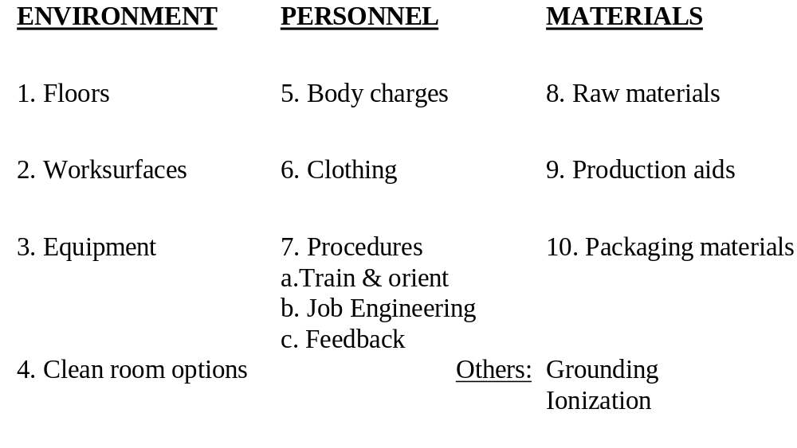
ESD CONTROL
10 points

Slide 111
ESD CONTROL simple AUDIT checklist
ESD Warning signs available ?
Which measurements are carried out and when. (Rapport available)
Control records for daily check of wrist-straps and shoes.
Training for ESD.

Slide 112
ESD CONTROL
Coordination PD Semiconductors
Coordination within PD:
Gijs Lijbers (QMS Eindhoven)
  - Packing.
Jos van de Giesen / Hyok Kwon (unofficial ESD Council)
  - Handling.
  - Standardization documents.

Slide 113
ESD CONTROL
Coordination PD Semiconductors
Each Plant/Product Group is responsible for their own ESD policy, however we try to have the same policy and approach for all Plants/Product Groups.

Slide 114
ESD ITEMS:
ESD GENERAL
ESD TESTING (Destructive)
ESD HANDLING
ESD PACKING
ESD STANDARDS
ESD CONTROL
QUESTIONS

Slide 115
ESD
Lets make things better

Slide 116


